Slide 1
ToroiseGit Overview
Dr. Michael Rahaim
Department of Electrical and Computer Engineering
Boston University
September 7th, 2016

Slide 2
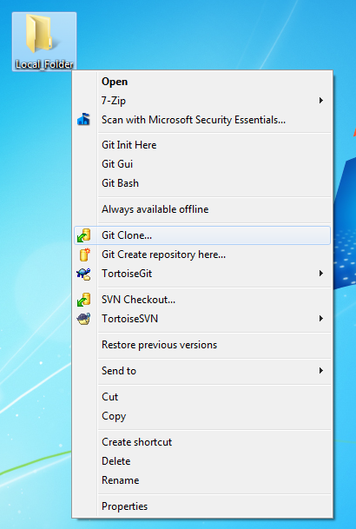
Create a new folder on your local directory
Select Git Clone to create a “clone” of the repository in your local directory

Slide 3
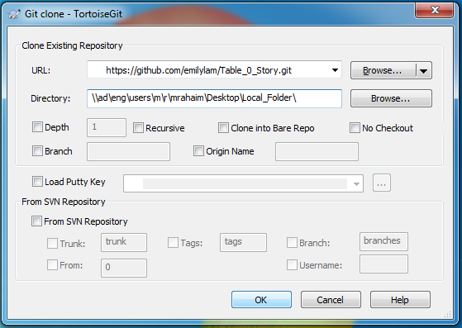
Enter the URL of the Repository that you are cloning.
Select OK
Enter your github user name and password when asked

Slide 4
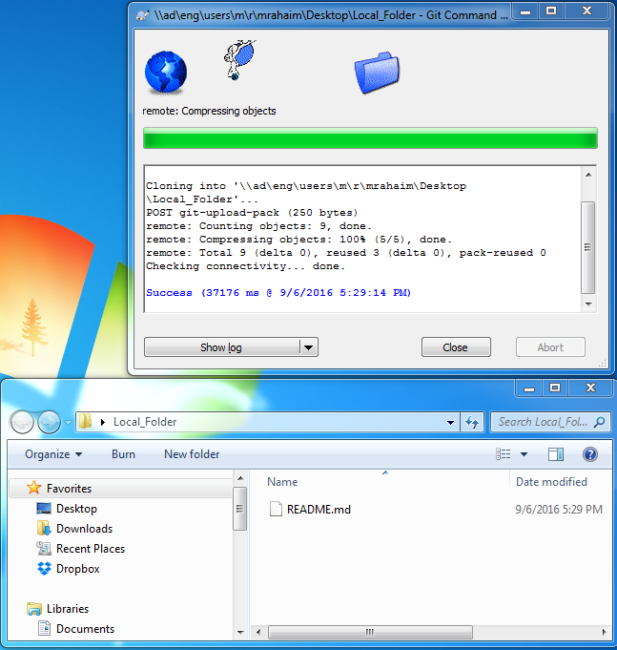
The contents of the repository should now be in your local folder.

Slide 5
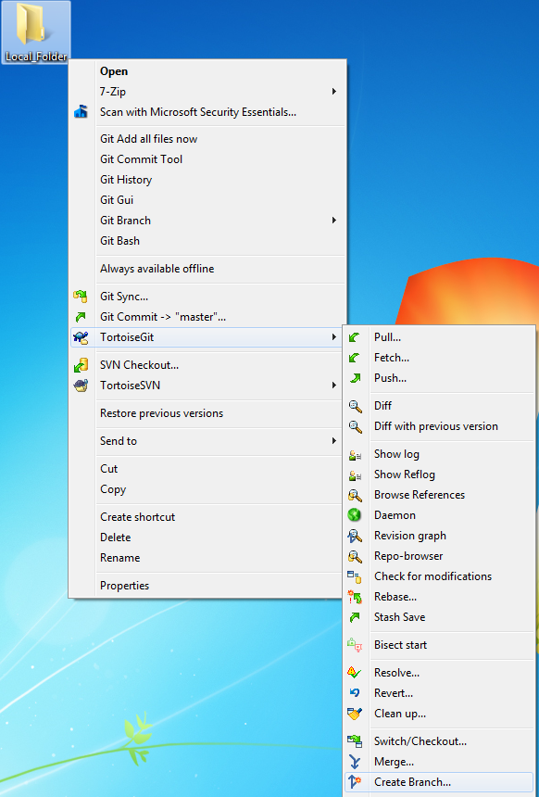
To create a new branch, right click on the local directory and select
TortoiseGit -> Create Branch

Slide 6
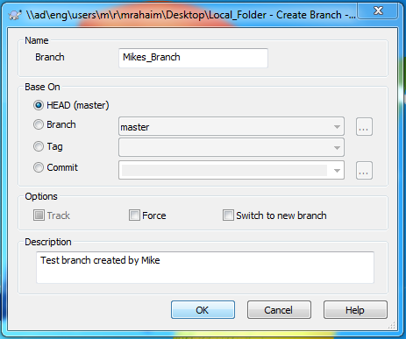
Give the branch a name and description, then select OK

Slide 7
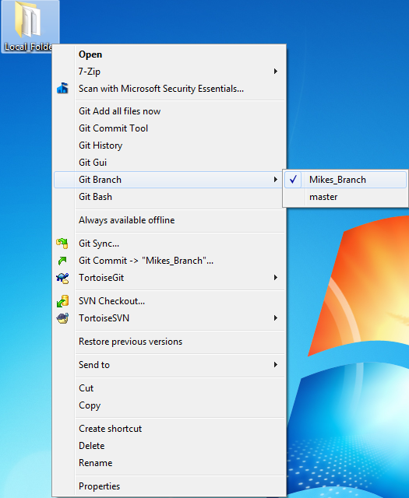
Right click again and make sure that the branch is set to your branch (i.e., not master)

Slide 8
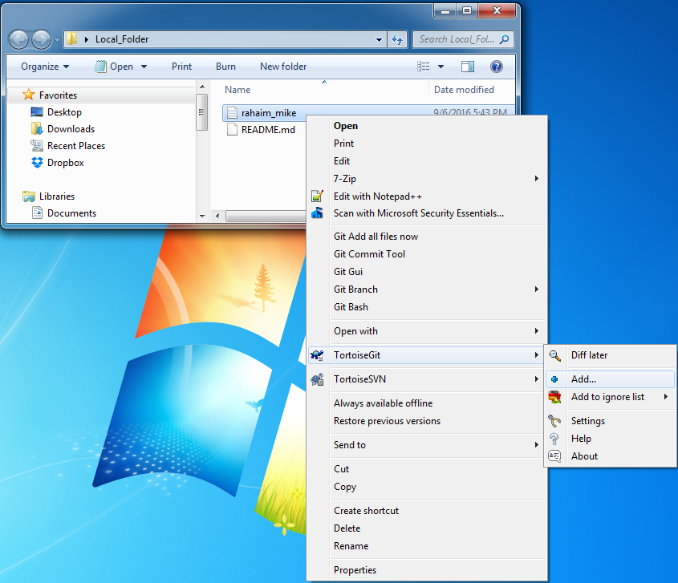
Once you’ve added a new file, add it as a tracked file in your local directory by right clicking ON THE FILE and selecting
TortoiseGit -> Add…

Slide 9
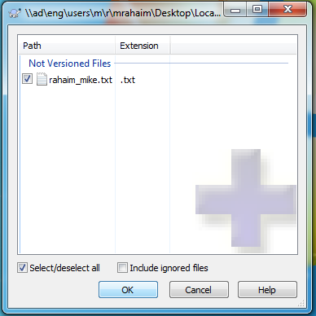
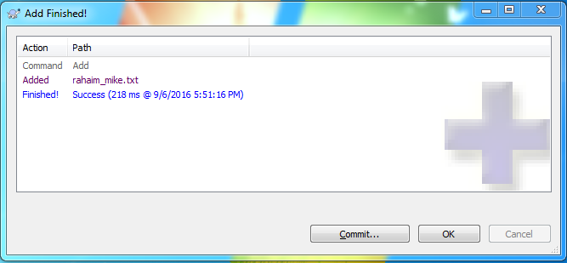
Make sure the file is selected, then press OK.
Once it has been added, select OK again (you can commit directly from this window; but we will do it from the main folder)

Slide 10
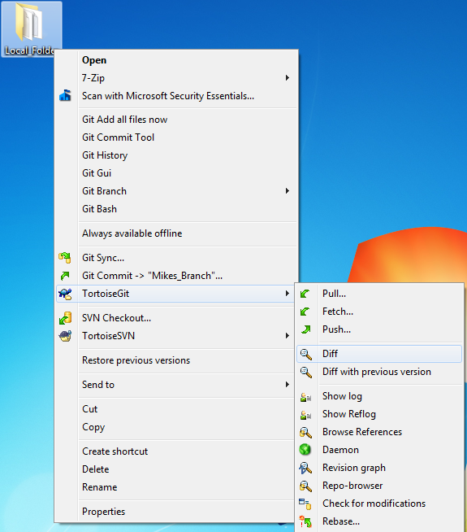
To see what has been changed since your last commit, right click on the local directory and select
TortoiseGit -> Diff

Slide 11
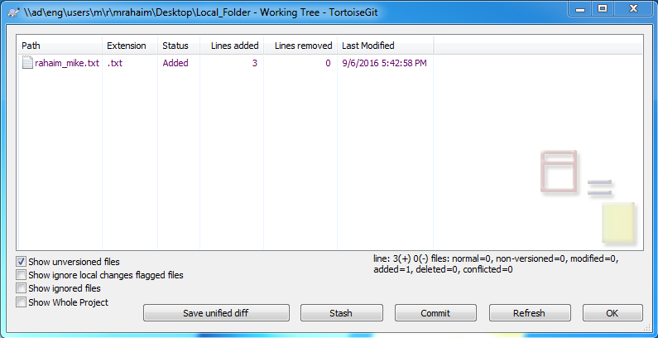
The window will show the changes that have not yet been committed to the branch.
To commit them to the branch, select Commit

Slide 12
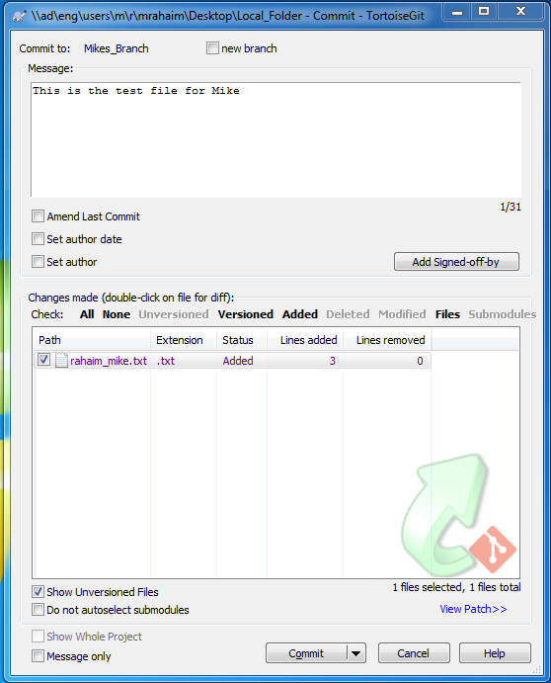
Fill in a message that describes what you are committing.
Make sure the added (or modified) file(s) are selected.
Select Commit

Slide 13
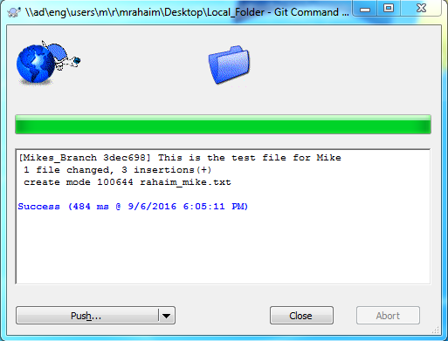
The update(s) have now been committed to your branch locally.
You can push this out to the central repository directly from here, or as described in the following.

Slide 14
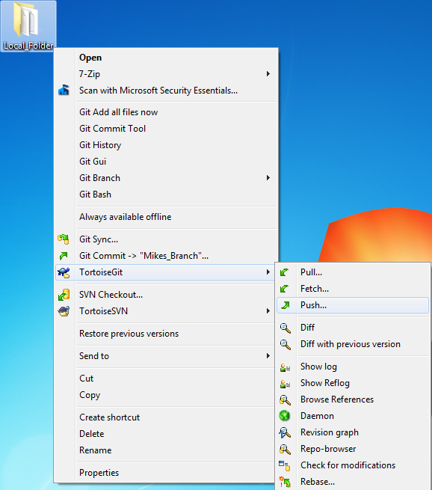
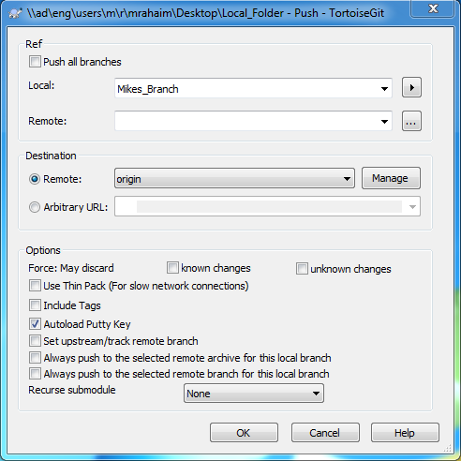
Once you are ready to push back to the central repository, right click on your local directory and select
TortoiseGit -> Push

Slide 15
If you look on github, your branch should now be updated!
The next step is to merge your branch back to the main branch in order to combine your work with your teammates work.

